Slide 1
Relationship Between Life Expectancy and GDP per capita
SOC 225 BA Lab Project Group 9
Jingzhao Huang, Lauren Liao, Wei Yang, Angela Zhao, Siyue Zhu
05/31/2020

Slide 2
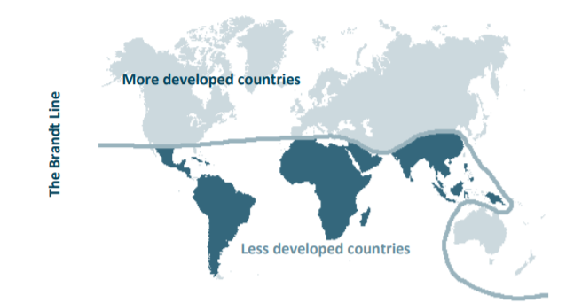
Research Question
The globalization and colonization shapes the depolarization of the world in economy
The inequality between global south and global north is our focus in this research

Slide 3
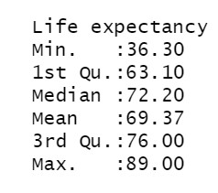
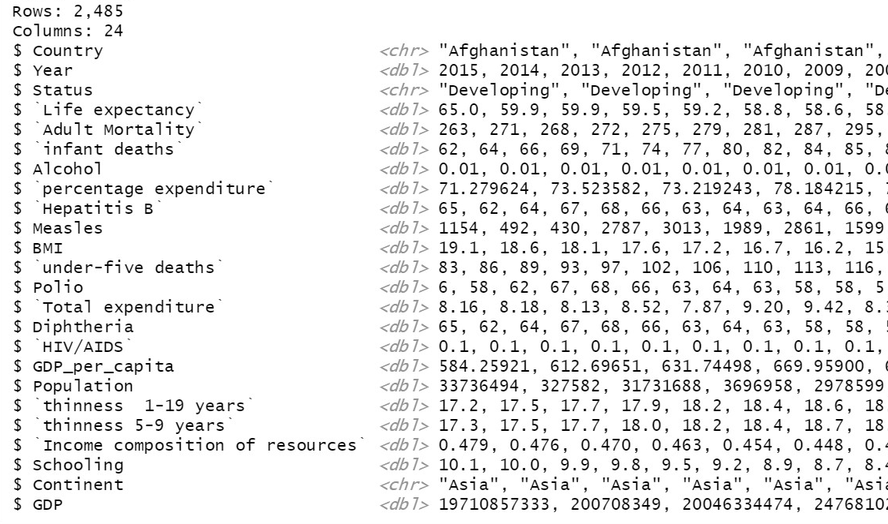
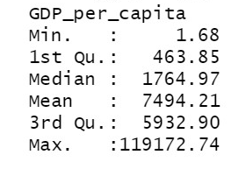
Data Collection
Source: https://www.kaggle.com/kumarajarshi/life-expectancy-who

Slide 4
Data Preparation
Merge two source of data
Clean NAs
Clean other missing variables: life expectancy = 0, GDP_per_capita = 0
Recode a variable: GDP → GDP_per_capita to avoid confusion
Create a numeric variable: GDP = GDP_per_capita * population

Slide 5
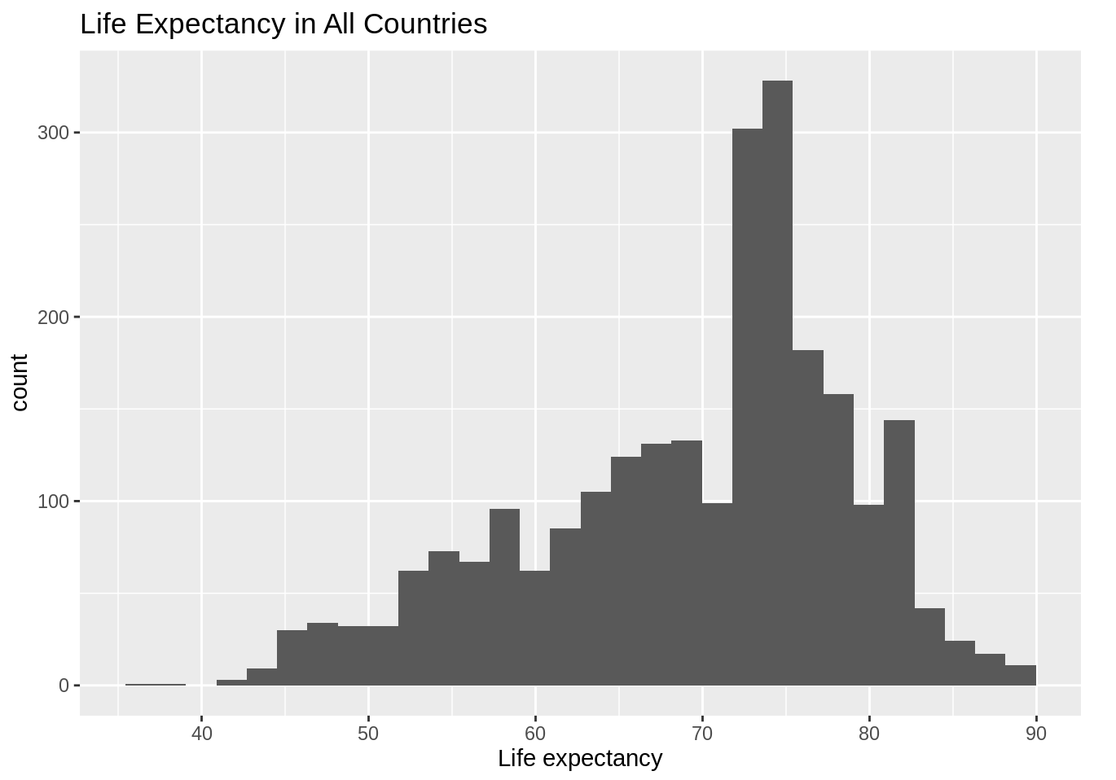
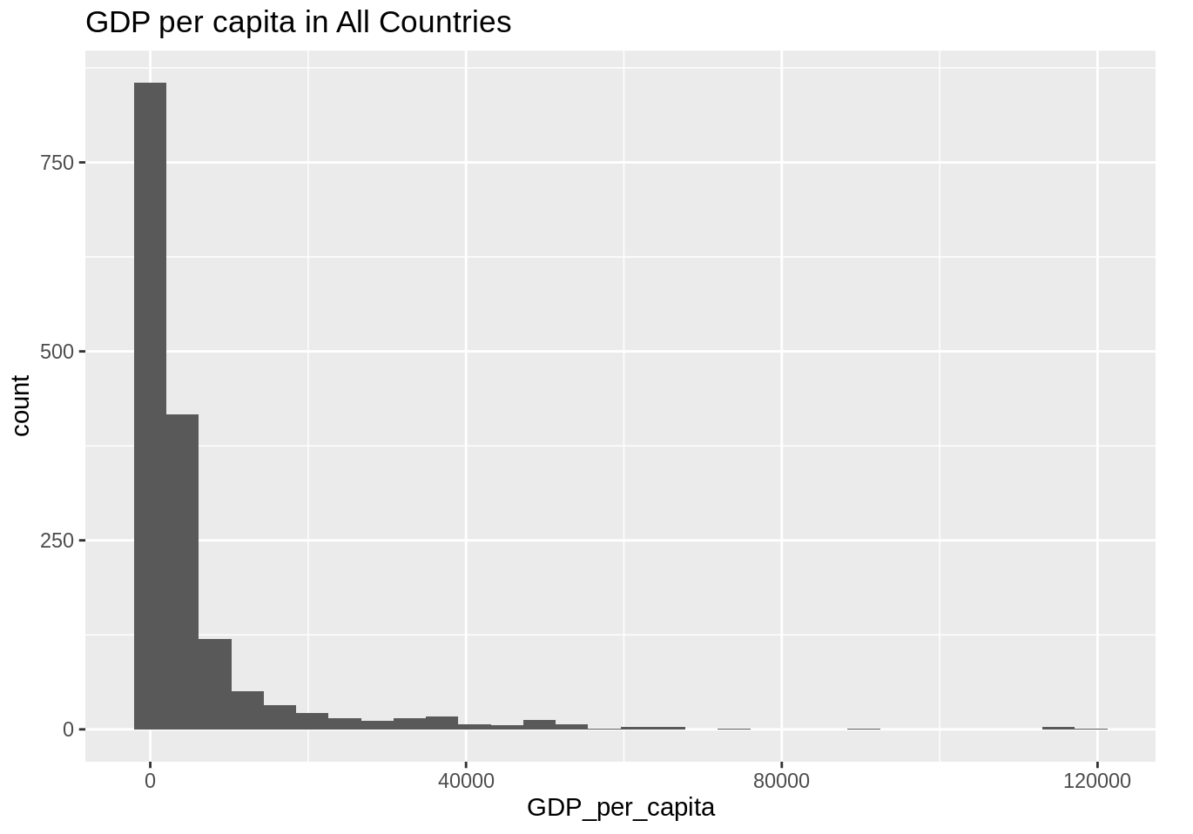
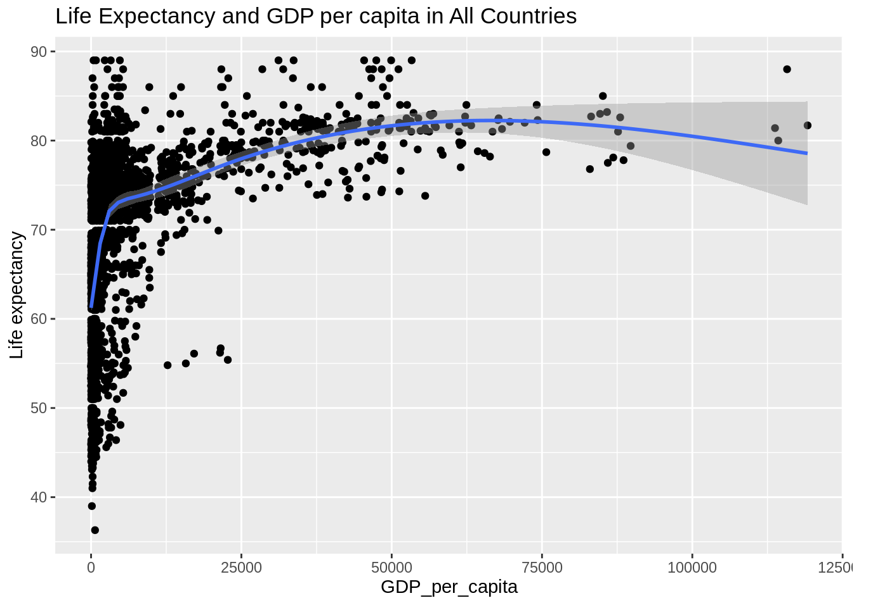
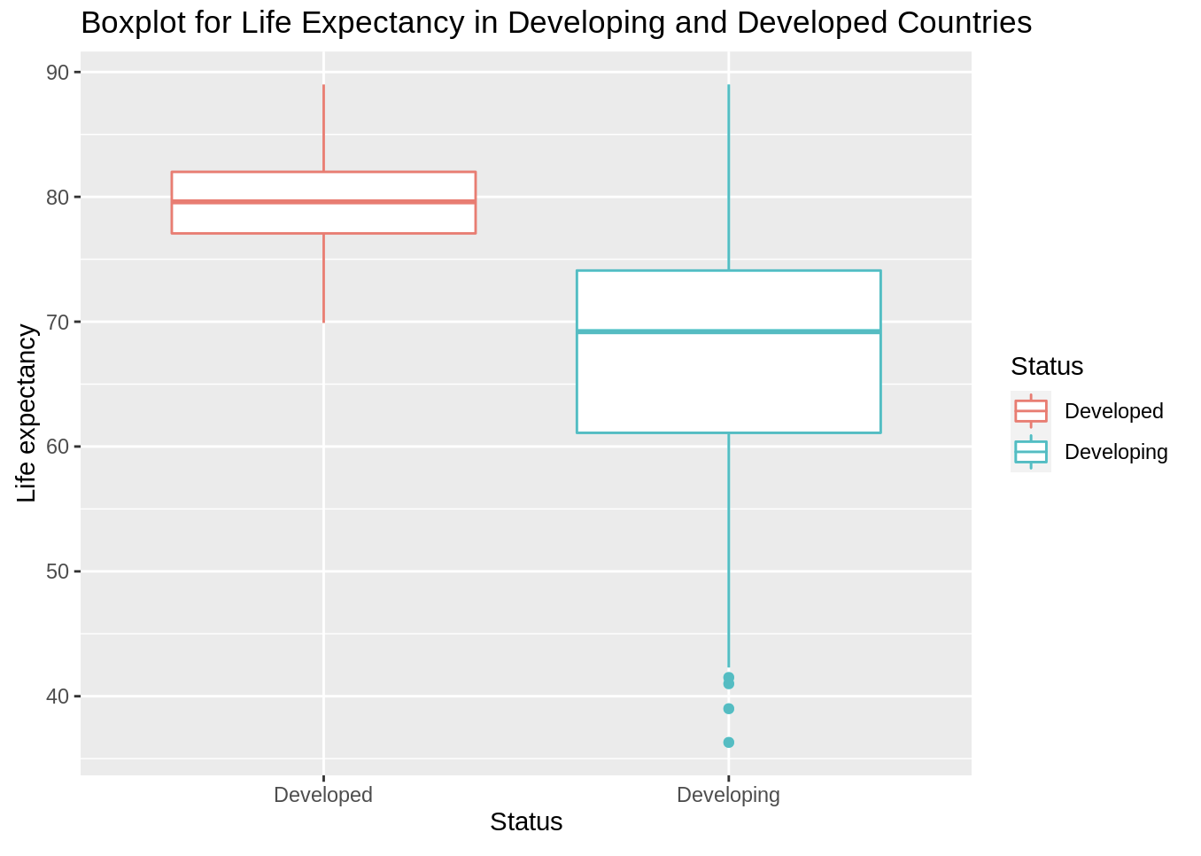
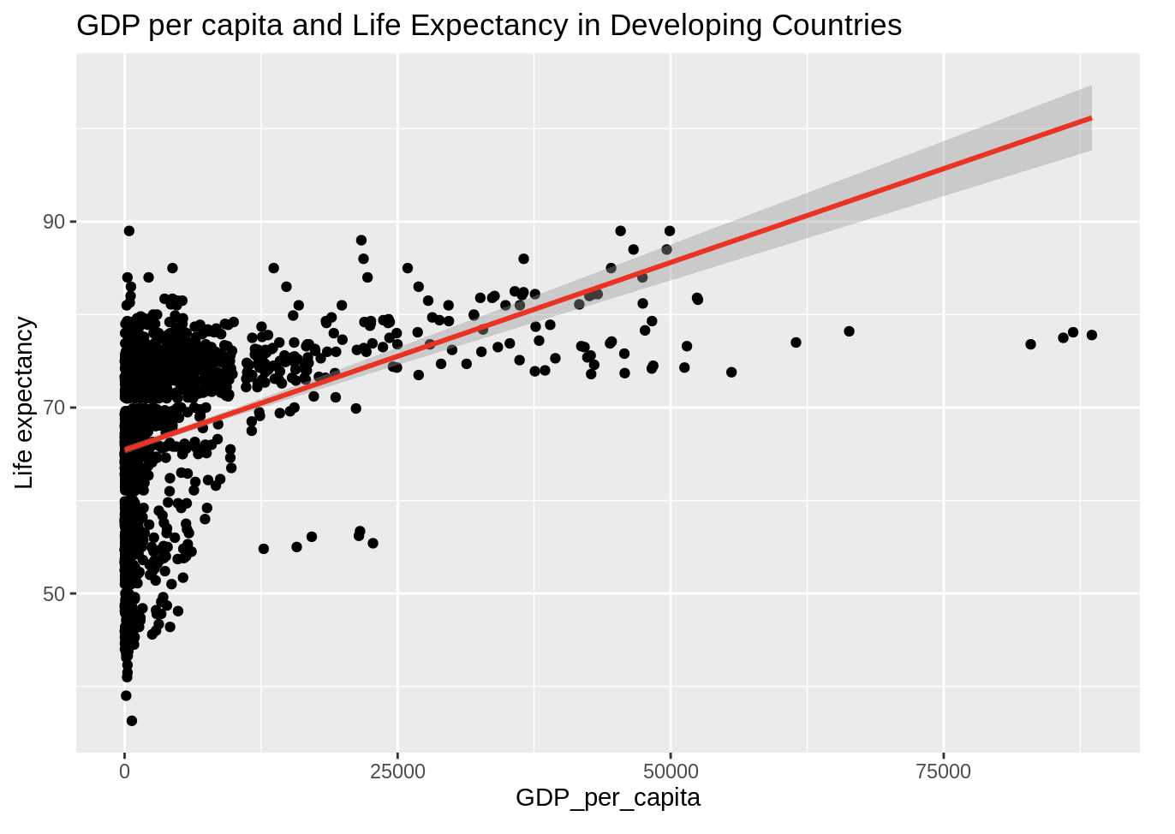
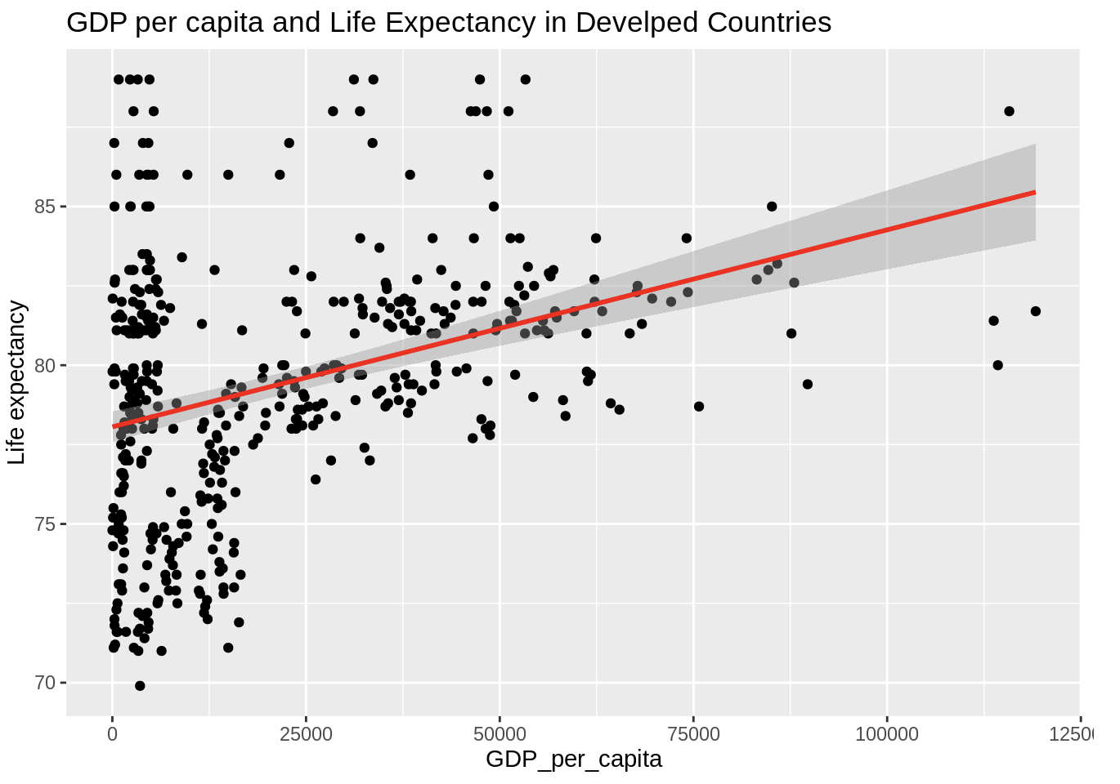
Visual Analysis

Slide 6
Discussion
Ethical Issues
Official data source and Macro-level dataset
Historical data without racial and sexual bias
Connection to the Data
We analysis life expectancy and GDP per capita to see their relationship
We also compare life expectancy in developed countries and developing countries to see if there is any difference under different developing status
Explanations of Visualization
Variable Expectancy: Histograms of life expectancy and GDP per capita, Boxplot of life expectancy in terms of status
Covariation: Scatterplot showing positive relation between life expectancy and GDP per capita among all countries and for both developing and developed countries separately.
Confidence
Highly confident about the accuracy
Reasons: datasets from WHO, holistic visualizations (country types, continents, years)
Limitations
Without considering geological factors
Only based on the data collected in 2000 - 2015

Slide 7
Thank you for your time

